Slide 1

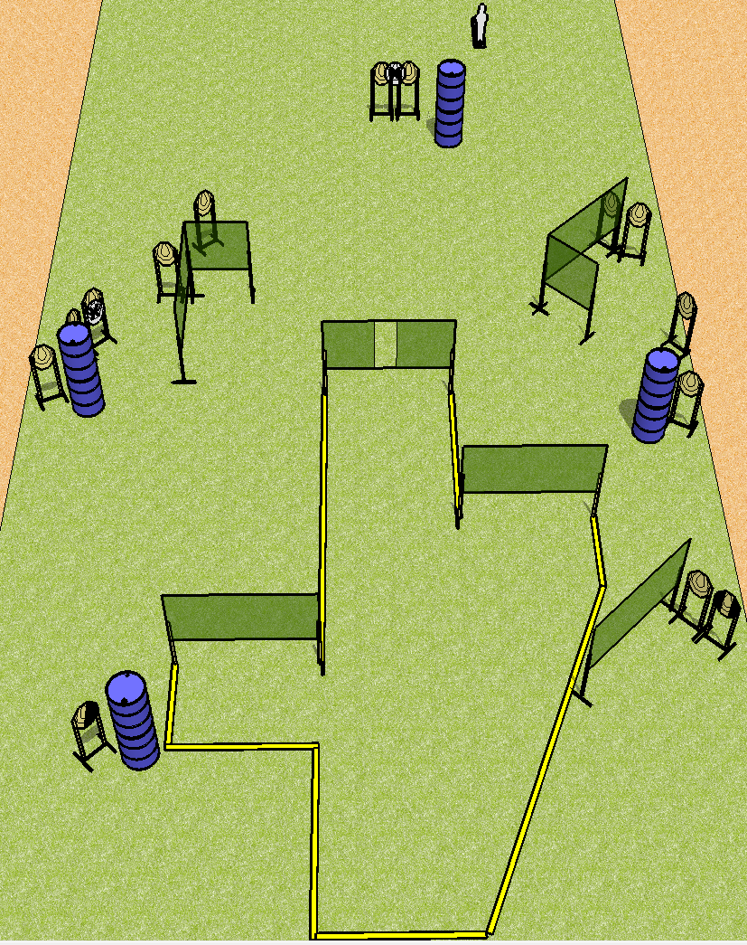
 | Dothan Practical Shooters – USPSA Match To The End Course Designer : Drew Coleman Bay: B1
Round Count 27 rounds 13 IPSC 1 pepper popper
Equipment List 14 wall feet 13 targets (11 + 2 NS) 1 tux, 1 right diag

Slide 2
To The End
Written Stage Briefing
Scoring: Comstock Rounds: 27
Targets: 13 IPSC, 1 steel
Handgun start position: anywhere completely outside the shooting area, wrists below belt. Handgun is loaded and holstered.
PCC start position: anywhere completely outside the shooting area, stock on belt. Loaded carbine is held with both hands, safety on.
Stage Procedure: on the audible start signal, engage targets as they become available from within the shooting area.

